Slide 1
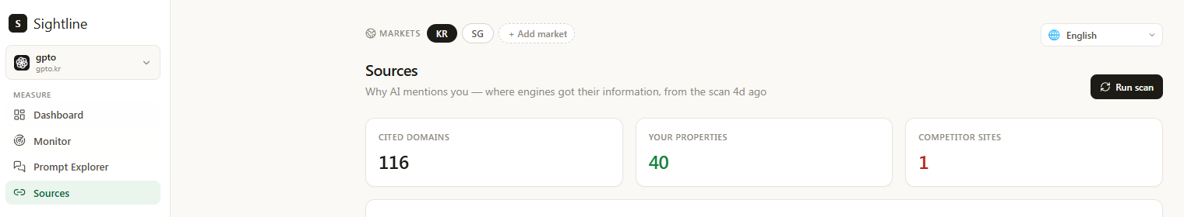
Feature Request: Sources Metrics Definitions & Naming
Figure 7 – Sources Dashboard Metrics
=========================================================
Sources Metrics Definitions & Naming
=========================================================
Refer to:
- Figure 7 – Sources Dashboard Metrics
Review the Sources dashboard metrics to ensure the metric names are clear, accurate, and not misleading.
Requirements:
- Rename metrics where needed to better reflect what is being measured.
- Add a plain-language tooltip for every metric.
- Show tooltips on hover (desktop) and tap (mobile).
- Explain what the metric measures and why it matters.
- Keep explanations concise and non-technical.
- Reuse existing tooltip/popover components.
- Apply this consistently across the Sources page.
The goal is to reduce ambiguity and help users immediately understand the metrics.

Slide 2
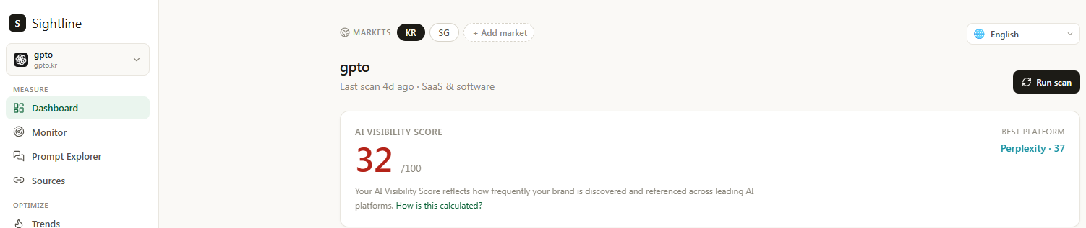
Feature Request: How It Works Link Behavior
Figure 8 – "How is this calculated?" User Flow
=========================================================
How It Works Link Behavior
=========================================================
Refer to:
- Figure 8 – "How is this calculated?" User Flow
Update the "How is this calculated?" link so it opens the public "How It Works" page in a new browser tab instead of navigating away from the dashboard.
Requirements:
- Open in a new tab on desktop.
- Preserve the user's current dashboard session.
- Keep the behavior consistent across all "How is this calculated?" links in the application.
- Ensure the experience works well on both desktop and mobile.
The goal is to let users view the methodology without interrupting their current workflow.
Notes:
How is this calculated?

Slide 3
Feature Request: How It Works Accessibility
=========================================================
How It Works Accessibility
=========================================================
The "How It Works" page should be publicly accessible.
Users must be able to view it without creating an account or logging in.
Add it to the public navigation and keep the experience consistent before and after login.
Do not gate this content behind authentication.
Notes:
How is this calculated?

Slide 4
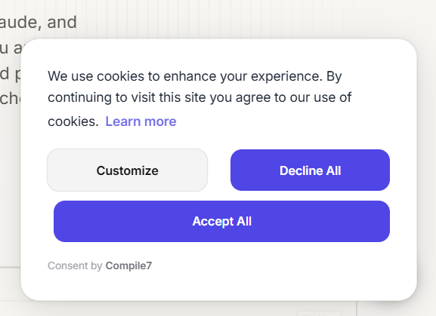
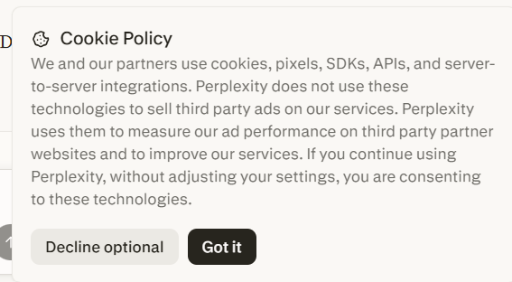
Feature Request: Cookie Consent Banner
- Figure 3 – Gracker.ai Cookie Consent Example
- Figure 4 – Perplexity Cookie Consent Example
=========================================================
Cookie Consent Banner
=========================================================
Implement a lightweight cookie consent banner that appears on the user's first visit.
Requirements:
- Display a non-intrusive banner or card at the bottom of the page.
- Include a brief explanation of cookie usage consistent with the existing Privacy Policy and Terms.
- Provide two actions: "Decline optional" and "Got it" (or equivalent wording).
- "Got it" accepts all cookies.
- "Decline optional" rejects non-essential cookies only.
- Persist the user's choice so the banner does not reappear.
- Do not block page content or require interaction before the user can browse.
- Keep the design consistent with the existing design system.
- Reuse existing components where possible.
The banner should align with industry-standard cookie consent practices without requiring a full cookie preference center.
Notes:
How is this calculated?

Slide 5
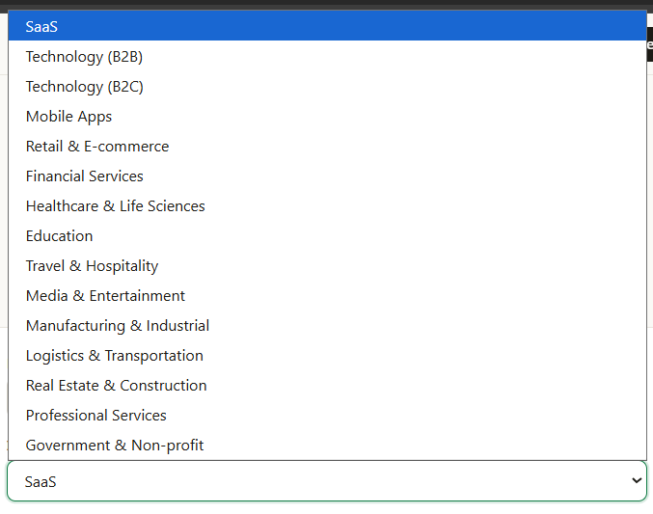
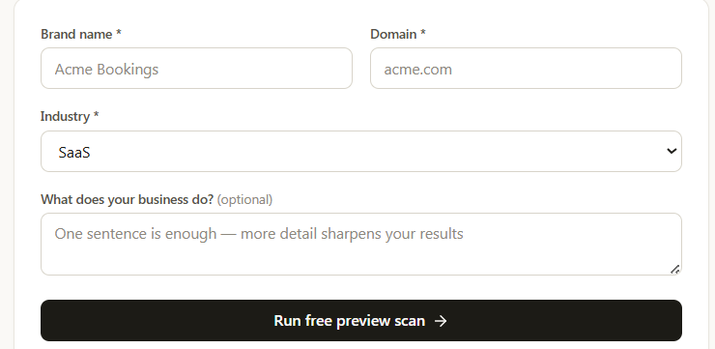


Feature Request: Industry Taxonomy
- Figure 6 – Current Industry Dropdown
- Figure 5 – Industry Field
=========================================================
Industry Taxonomy
=========================================================
Replace the current Industry dropdown with a simpler, MECE taxonomy.
Categories:
- Software & SaaS
- Consumer Technology
- Professional Services
- E-Commerce & Retail
- Financial Services
- Healthcare & Life Sciences
- Education
- Government & Non-Profit
- Other Industries
Add a short helper text beneath the Industry field that updates based on the selected category.
Example helper text:
- Software & SaaS — B2B software, cloud platforms, enterprise solutions.
- Consumer Technology — Mobile apps, consumer products, electronics.
- Professional Services — Agencies, consulting, legal, accounting.
- E-Commerce & Retail — Online stores, marketplaces, retail brands.
- Financial Services — Banking, fintech, insurance, wealth management.
- Healthcare & Life Sciences — Healthcare, pharma, biotech, healthtech.
- Education — EdTech, schools, universities, training.
- Government & Non-Profit — Public sector, NGOs, charities.
- Other Industries — Manufacturing, real estate, travel, logistics, media, energy and other sectors.
Keep the helper text concise, responsive, and easy to read on both desktop and mobile.
Update the backend taxonomy, mappings, validation, and benchmark generation to use the same categories as the frontend.
The frontend and backend must remain fully aligned to ensure consistent benchmarking and avoid ambiguity.
Notes:
How is this calculated?

Slide 6
Feature Request: Pricing Table UX Improvements
=========================================================
Pricing Table UX Improvements
=========================================================
Improve the pricing table to make plan differences clearer and reduce confusion during the buying journey.
Requirements:
- Move the explanation for "Team collaboration (seats)" directly beneath the feature name in smaller italic text.
Suggested copy:
"Members can run scans and generate content. Viewers have read-only access."
- Surface the Pro plan value within the table instead of relying on notes below it.
Clearly indicate that Pro includes everything in Starter along with higher limits and additional features, without duplicating the entire feature list.
- Keep only billing-related notes below the pricing table, such as:
- Cancel anytime — your plan remains active until the end of the current billing period.
- Annual billing (2 months free) coming soon.
Reuse the existing layout and components.
The goal is to improve clarity, highlight the Pro plan value, and create a smoother buying experience without adding visual clutter.
Notes:
How is this calculated?

Slide 7
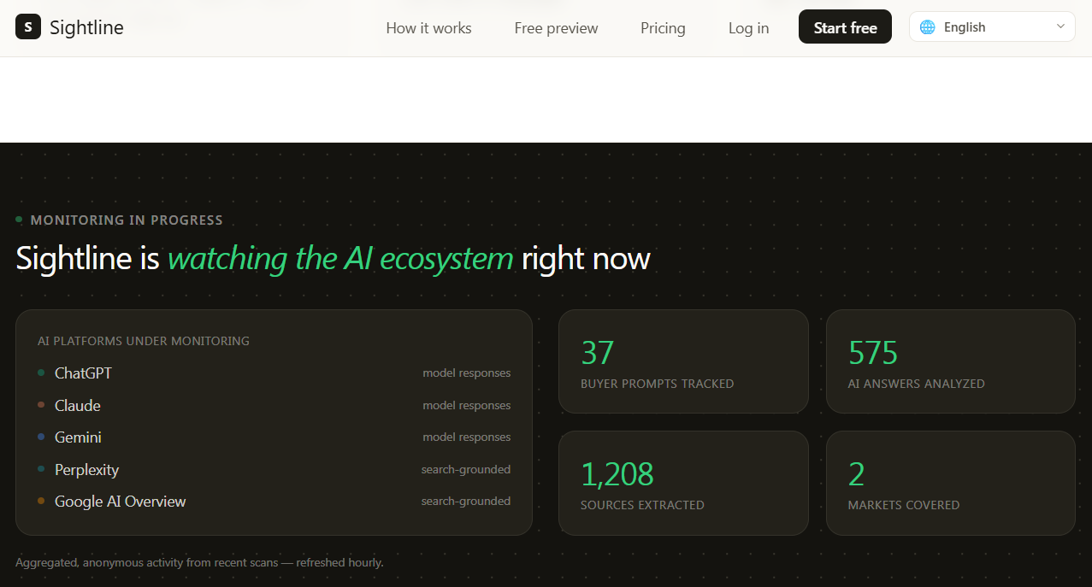
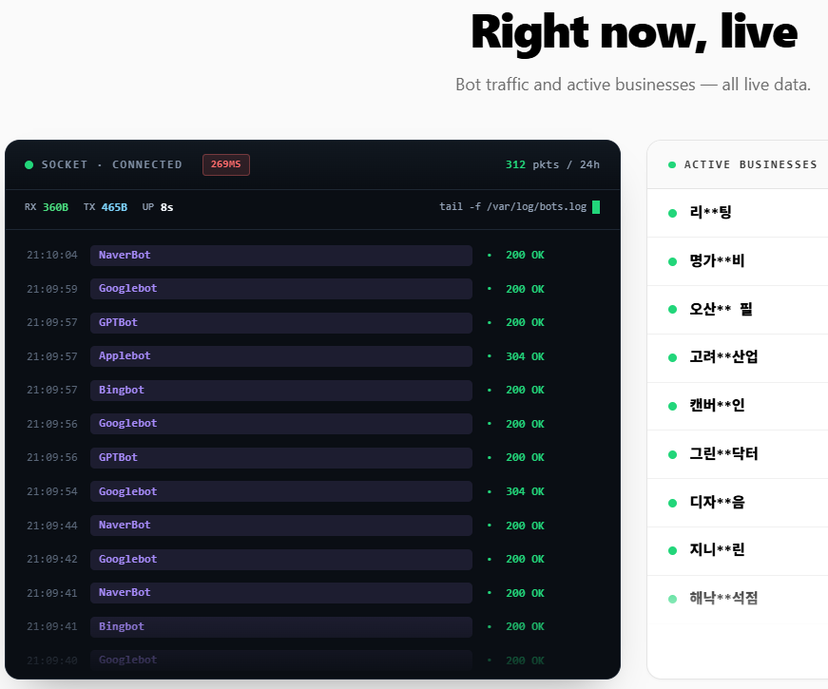
Feature Request: Hero Monitoring Section (Landing Page)
- Figure 1 – Current Hero Monitoring Section
- Figure 2 – Desired Hero Monitoring Experience (competitor)
=========================================================
Hero Monitoring Section (Landing Page)
=========================================================
Refer to:
- Figure 1 – Current Hero Monitoring Section
- Figure 2 – Desired Hero Monitoring Experience
Update the hero monitoring section on the public landing page to better communicate that Sightline continuously monitors AI visibility.
Requirements:
- Refresh the visual presentation to feel more active and engaging, inspired by Figure 2.
- Emphasize ongoing monitoring and analysis without exposing implementation details.
- Display only high-level, non-sensitive information suitable for prospective users.
- Do not expose customer data, proprietary metrics, internal operations, or platform scale.
- Reuse existing components where possible and keep the implementation lightweight.
- Keep the design consistent with the existing design system.
The goal is to increase user confidence and communicate that Sightline continuously analyzes AI visibility while protecting proprietary information.
Notes:
How is this calculated?

